Slide 1

Media Server

Slide 2
What is a Media Server
A media server is a device that stores and shares media. It is responsible for hardware as well as software aspects of successful storing and retrieval as well as sharing of media files and data. A media server can be any device having network access and adequate bandwidth for sharing and saving of media. A server, PC, network-attached storage (NAS) or any other device with such storage capability can be used as a media server. Commercial media servers act as aggregators of information: video, audio, photos and books, and other types of media can all be accessed via a network.

Slide 3
Types of Media
Movies/TV Shows
Music
Photos
E-Books
Comic Books
Games

Slide 4
Media Software
Plex https://plex.tv (Free, $4.99 monthly, $39.99 annually, or $119.99 life-time)
Emby https://emby.media/ (Free, $4.99 month, $54 annual, or $119 life-time)
Jellyfin https://jellyfin.org/ (Free)
Calibre-Web https://github.com/janeczku/calibre-web (Free)
Ubooquity https://vaemendis.net/ubooquity/ (Free)
Kavita Reader https://kavitareader.com (Free)

Slide 5
Plex
Plex gives you one place to find and access all the media that matters to you. From personal media on your own server, to free and on-demand Movies & Shows or live TV, to streaming music, you can enjoy it all in one app, on any device.

Slide 6
Emby
Emby is a media system that allows you to gather all your media content in one place for easy accessibility. Just like Jellyfin, with your Emby server, you can automatically and quickly convert your media to play on different devices.
Despite being launched earlier, the media system received a stable release in March 2021 with great upgrades, making accessing personal media away from home efficient. Similar to Jellyfin, Emby allows you to stream pre-recorded live TV content.
The platform also helps with DVR management and, like Jellyfin, Emby is a personal media server. That means it does not allow you to stream or download new content. It only helps you to manage your existing media.

Slide 7
Jellyfin
Jellyfin is a Free Software Media System that puts you in control of managing and streaming your media. It is an alternative to the proprietary Emby and Plex, to provide media from a dedicated server to end-user devices via multiple apps. Jellyfin is descended from Emby's 3.5.2 release and ported to the .NET Core framework to enable full cross-platform support. There are no strings attached, no premium licenses or features, and no hidden agendas: just a team who want to build something better and work together to achieve it. We welcome anyone who is interested in joining us in our quest!

Slide 8
Calibre-Web
Calibre-Web is an eBook viewer which uses an existing Calibre database to pull content. We do not run the stand alone version of Calibre, but instead use a build of LazyLibrarian which has Calibre built in.
Some of Calibre-web’s features include:
Full HTML5 GUI.
User management with per-user permissions
Custom shelves
Editing eBook metadata
Send eBooks to Kindle devices
Reading eBooks directly in a browser

Slide 9
Ubooquity
Ubooquity is small content server that you can use on any device on which Java is installed (virtually everything running on Windows, Linux or Mac OS, including NAS). Once installed, it runs in the background and makes all the comics and books you chose to share available through a web page. The idea behind Ubooquity is to be able to browse your personal digital library from your tablet (e.g an iPad), your e-reader or your smartphone, either at home or from anywhere else.

Slide 10
Kavita Reader
Kavita is a fast, feature rich, cross platform reading server. Built with a focus for manga and the goal of being a full solution for all your reading needs. Setup your own server and share your reading collection with your friends and familly

Slide 11
Plex Pass Features
Downloads – Allows you to download videos to your phone or tablet to view while off your network.
HDR Tone Mapping - Enjoy your SDR and HDR content on any screen without distorted colors ruining the vibe.
Ultimate TV & DVR - With Plex Pass plus your tuner and antenna, you can watch, rewatch, and record your favorite HD broadcast content.
Trailers & Extras - Create your own cinema experience with trailers that play before your movie. Dive into a movie with extras like deleted scenes and gag reels.

Slide 12
Plex Pass Features
Skip Intro - Ready to start a series marathon? Say so long to those long intros and hello to the power to binge shows better.
Plex Dash - Fix up artwork. Refresh libraries. Inspect nerdy media details using our exclusive custom app.
Multi-Colored Themes - Enhance your viewing experience with interface color themes reserved for Plex Pass members only.

Slide 13
Plexamp Features
Car Compatible - No more asking your copilot to cue up the music. Plexamp can be used with your car’s CarPlay or Android Auto.
Super Sonic - We’ve added a sophisticated neural network which analyzes your music library, powering amazing new features.
Offline Bliss - Download albums, playlists, or stations. Simple and powerful offline support for when you’re on an off-road adventure.
Music to Your Eyes - Get UltraBlur backgrounds, over a dozen hypnotic visualizers, and four visual themes to satisfy every taste.

Slide 14
Plex
Lon Seidman https://www.youtube.com/@LonSeidman
NASCompares https://www.youtube.com/channel/UCFyP17HoU-vpxhIpGXnXx2g
Plex Guide 2022 https://www.youtube.com/watch?v=iDxT9WsxHr4
Plex Support Articles https://support.plex.tv/articles/

Slide 15
Emby Premier Features
Downloads – Allows you to download videos to your phone or tablet to view while off your network.
Emby DVR – Schedule recordings and more.
Free Apps – Full access to Emby for Android, iOS, Fire TV, Xbox One and PS4.

Slide 16
Emby Premier Features
Hardware Accelerated Transcoding.
Cinema Intros.
CarPlay/Android Auto.
Automatically Convert Content into streaming friendly formats.

Slide 17
Emby Premier Features
Cover Art plugin creates fun covers and other treatments for you media images.
Backup and Restore your configuration.
Folder Sync to folders or external devices.
Smart Home for Amazon Echo or Google Home devices.

Slide 18
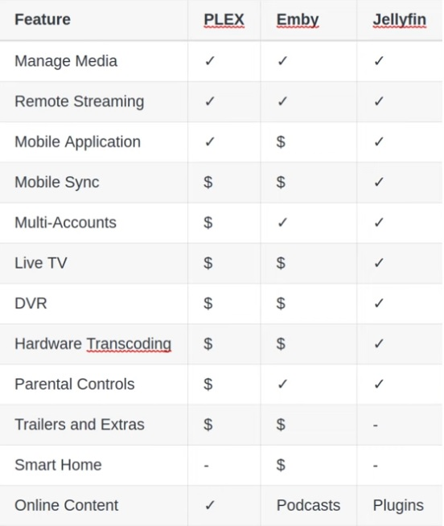

Slide 19
Kodi
Kodi is an open source software media center, allowing you to access all kinds of content, including videos and music. You can run that content on any device of your choosing, including your TV, laptop, phone, tablet and others. You can even run Kodi on your Raspberry Pi.
Kodi comes with its own user interface and works with both local and network storage services you’re already using. Be aware, though, that it doesn’t come with content out of the box. There are also some third-party add-ons you can use to enhance your Kodi experience. This might sound like a lot of work, and if you have the money, you may have better luck with just paying for the best streaming services.

Slide 20
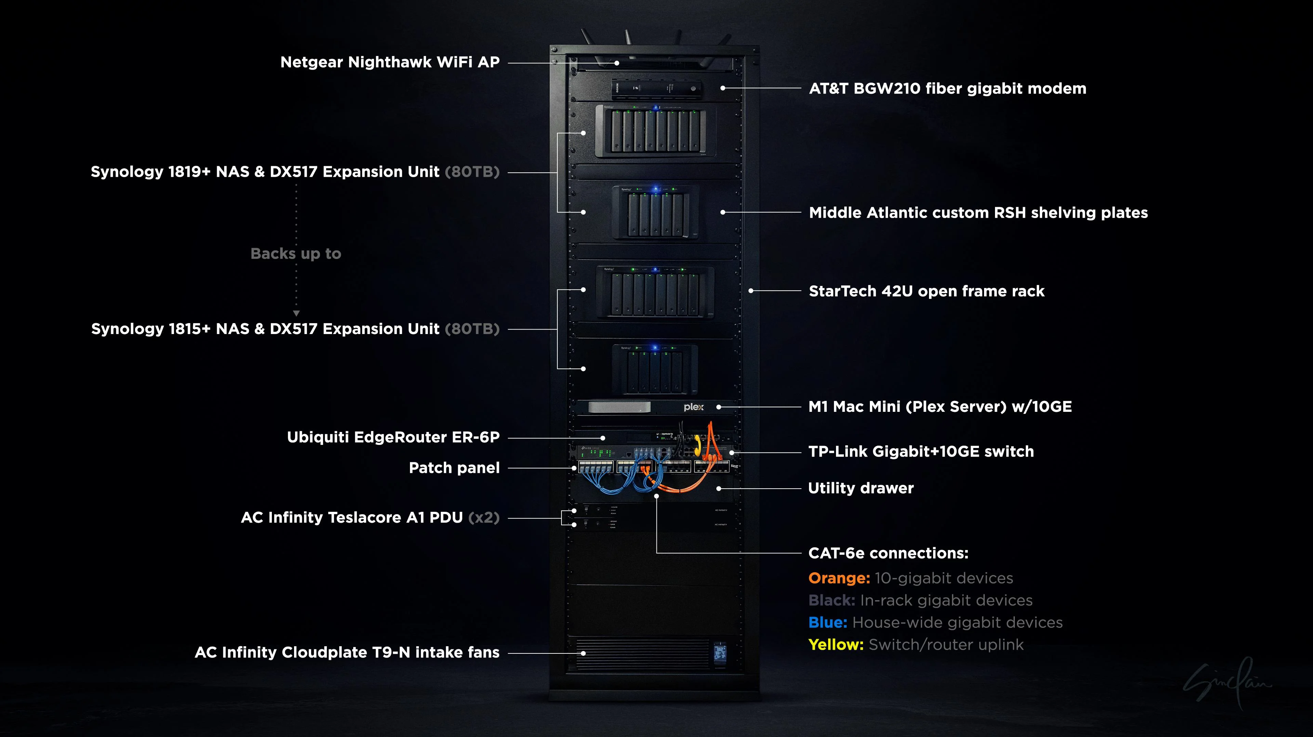

Slide 21

Cochise Linux User Group

